Slide 1
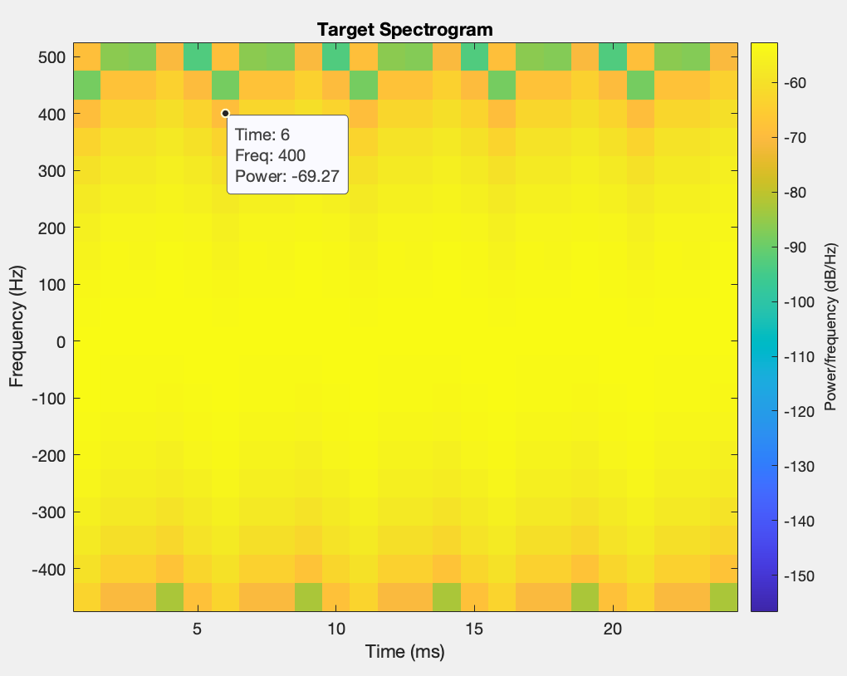
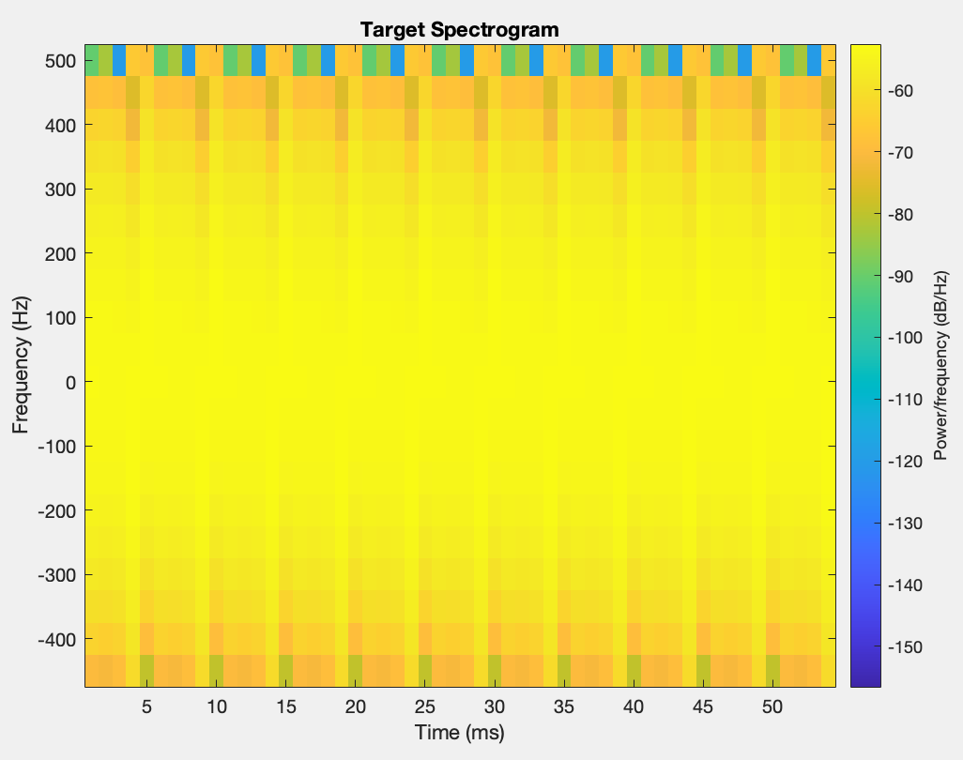

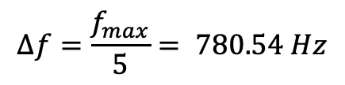









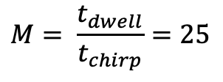

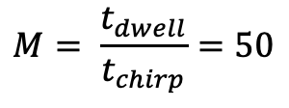
Drone’s spectrograms
Quadcopter drone
$Δt= T_{c}$/5 = 1 ms
$$Δf=\frac{f_{max}}{5}= 780.54 Hz$$
$$\frac{1}{T_{c}}≠2f_{max}$$
$$t_{chirp}=1 ms$$
$$M= \frac{t_{dwell}}{t_{chirp}}=50$$
$$t_{chirp}=1 ms$$
$$M= \frac{t_{dwell}}{t_{chirp}}=25$$
$Δt=\frac{N{ t}_{chirp}}{2 }$ = 1ms
$$t_{dwell}=50ms$$
$$t_{dwell}=25ms$$
$Δf=\frac{1}{N{ t}_{chirp}}$ = 500 Hz
$N=\frac{2Δt}{{ t}_{chirp}}$ = 2
$N=\frac{2Δt}{{ t}_{chirp}}$ = 2

Slide 2
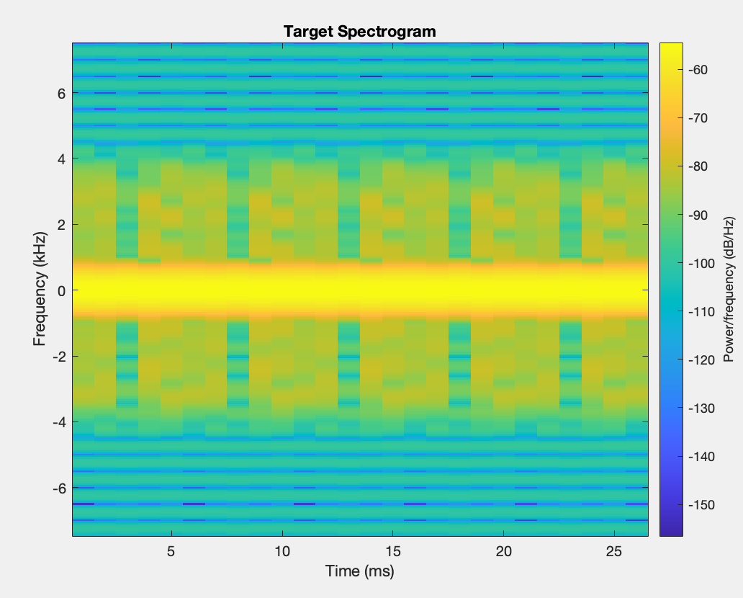
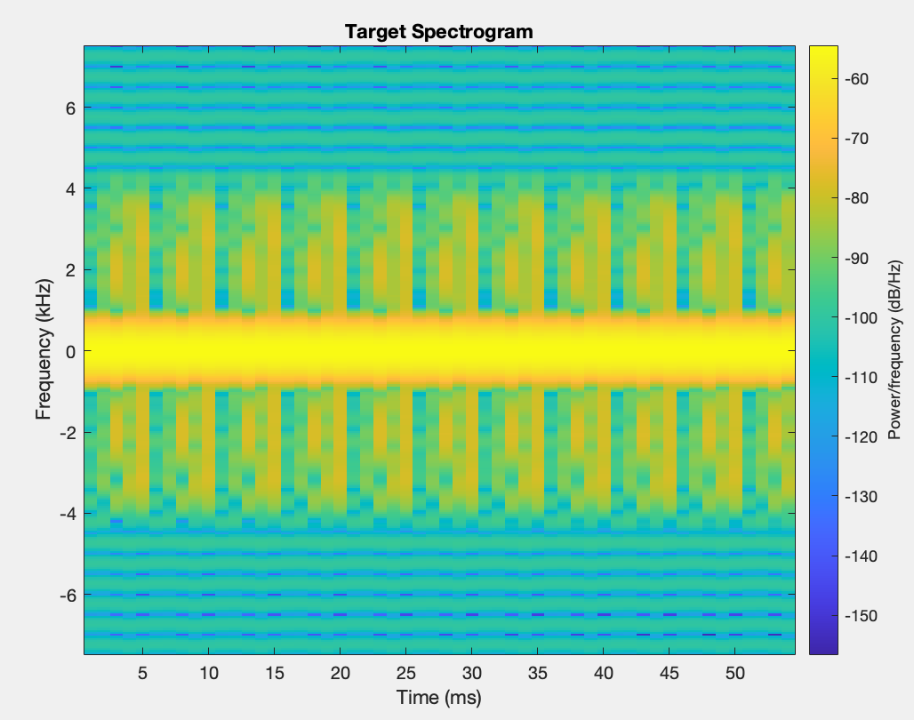
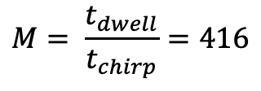




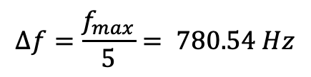

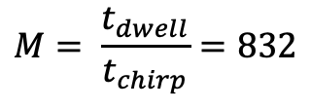
Drone’s spectrograms
Quadcopter drone
$Δt= T_{c}$/5 = 1 ms
$$Δf=\frac{f_{max}}{5}= 780.54 Hz$$
$$t_{chirp}=66.7 μs$$
$$M= \frac{t_{dwell}}{t_{chirp}}=832$$
$$t_{chirp}=66.7 μs$$
$$M= \frac{t_{dwell}}{t_{chirp}}=416$$
$Δt=\frac{N{ t}_{chirp}}{2 }$ = 1ms
$$t_{dwell}=55ms$$
$$t_{dwell}=25ms$$
$N=\frac{2Δt}{{ t}_{chirp}}$ = 30
$Δf=\frac{1}{N{ t}_{chirp}}$ = 500 Hz
$N=\frac{2Δt}{{ t}_{chirp}}$ = 30

Slide 3
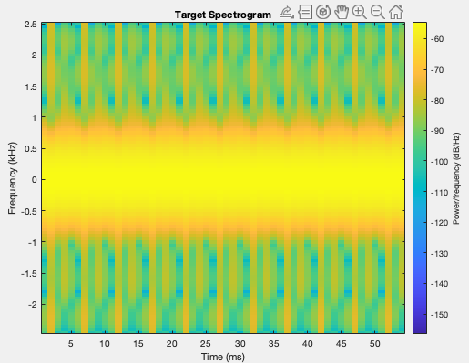
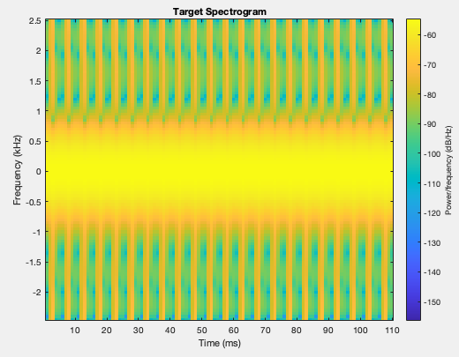
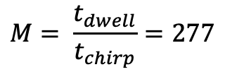


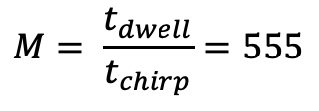



Drone’s spectrograms
Quadcopter drone
$Δt= T_{c}$/5 = 1 ms
$$Δf=\frac{f_{max}}{5}= 780.54 Hz$$
$$t_{chirp}=0.2 ms$$
$$M= \frac{t_{dwell}}{t_{chirp}}=555$$
$$t_{chirp}=0.2 ms$$
$$M= \frac{t_{dwell}}{t_{chirp}}=277$$
$Δt=\frac{N{ t}_{chirp}}{2 }$ = 1ms
$$t_{dwell}=55ms$$
$$t_{dwell}=25ms$$
$N=\frac{2Δt}{{ t}_{chirp}}$ = 10
$Δf=\frac{1}{N{ t}_{chirp}}$ = 500 Hz
$N=\frac{2Δt}{{ t}_{chirp}}$ = 10

Slide 4
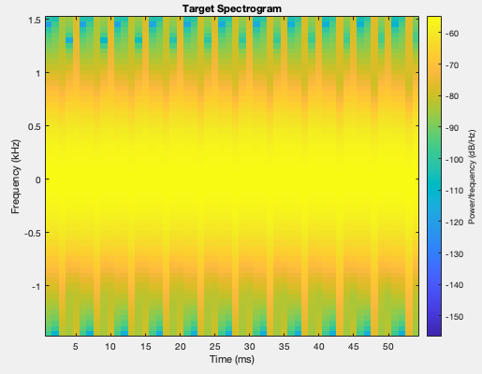
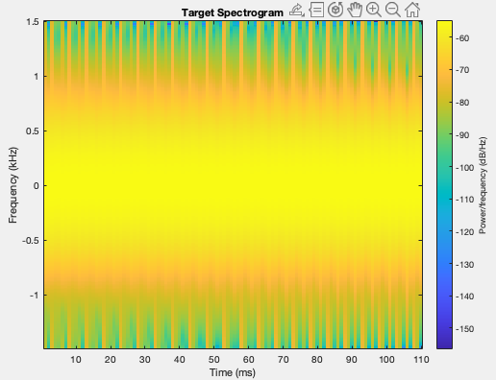
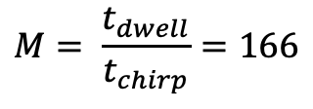


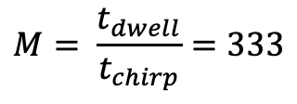




Drone’s spectrograms
Quadcopter drone
$Δt= T_{c}$/5 = 1 ms
$$Δf=\frac{f_{max}}{5}= 780.54 Hz$$
$$M= \frac{t_{dwell}}{t_{chirp}}=166$$
$$t_{chirp}=0.3 ms$$
$$M= \frac{t_{dwell}}{t_{chirp}}=333$$
$$t_{chirp}=0.333 ms$$
$Δt=\frac{N{ t}_{chirp}}{2 }$ = 1ms
$$t_{dwell}=110ms$$
$$t_{dwell}=55ms$$
$N=\frac{2Δt}{{ t}_{chirp}}$ = 6
$Δf=\frac{1}{N{ t}_{chirp}}$ = 500 Hz
$N=\frac{2Δt}{{ t}_{chirp}}$ = 6

Slide 5
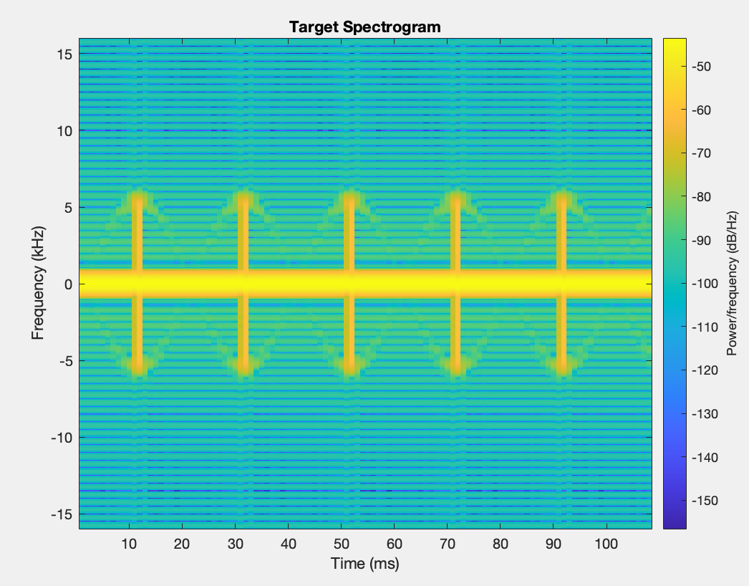
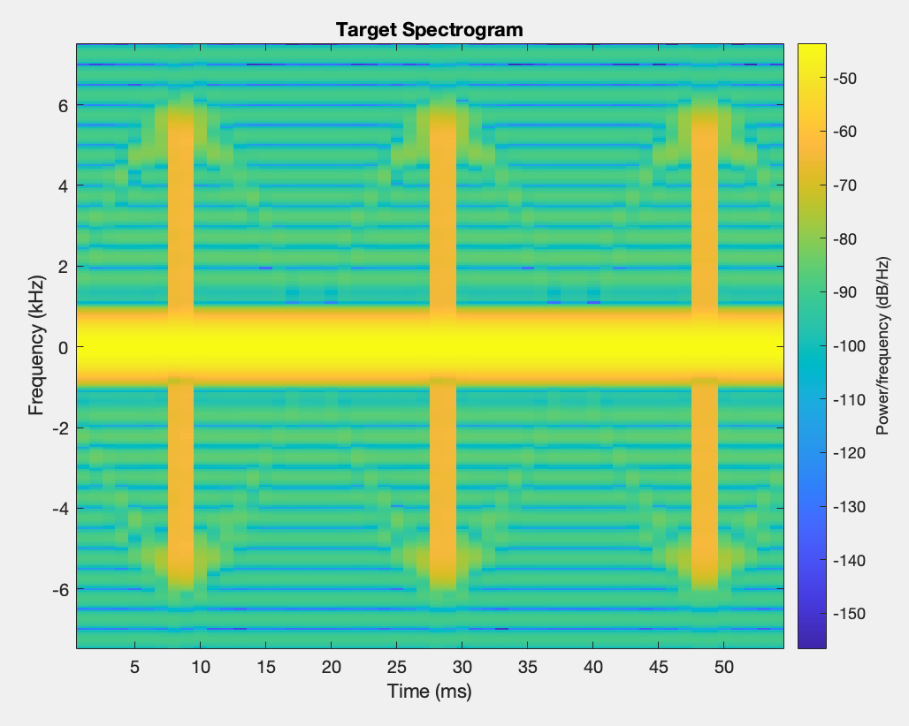
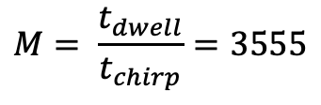


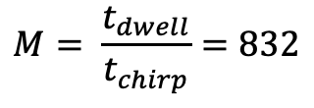
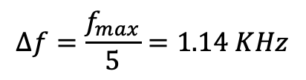







Drone’s spectrograms
Helicopter drone
$Δt= T_{c}$/5 = 4 ms
$$Δf=\frac{f_{max}}{5}=1.14 KHz$$
$$M= \frac{t_{dwell}}{t_{chirp}}=3555$$
$$t_{chirp}=66.7μs$$
$$M= \frac{t_{dwell}}{t_{chirp}}=832$$
$$t_{chirp}=31. 25μs$$
$Δt=\frac{N{ t}_{chirp}}{2 }$ = 2ms
$$t_{dwell}=55ms$$
$$t_{dwell}=0.111s$$
$N$= 64
$Δf=\frac{1}{N{ t}_{chirp}}$ = 250 Hz
$N$= 30

Slide 6
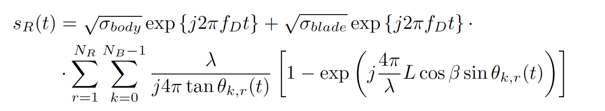
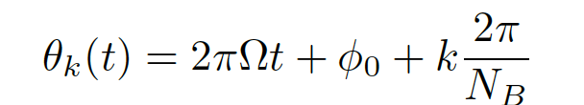
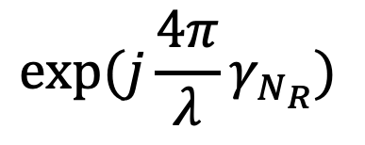
Phase contribution of rotors position
$$exp⁡(j\frac{4π}{λ}γ_{N_{R}})$$
After integration on entire pale length, this therm take into
account the distance of rotor from CM
Assuming the length and width of a drone as in the case of DJI mini 2, L = 202mm W = 160mm
A rectangular model considered to determine $γ_{N_{R}}$ is shown in the next slide

Slide 7












Phase contribution of rotors position
rotor
L/2
CM
$$β$$
When$β=0$
z
$γ=\frac{L}{2}cos⁡(β$)
$$γ=L/2$$
$$β$$
x
L = 202mm
0
When $α=0$
y
CM
$$γ=\frac{W}{2}$$
W/2
$$α$$
$$α$$
$γ=W/2 sin(α$)
x
Alla fine assumo v.a. uniforme $γ$
Nel suo range Massimo per ogni rotore

Slide 8
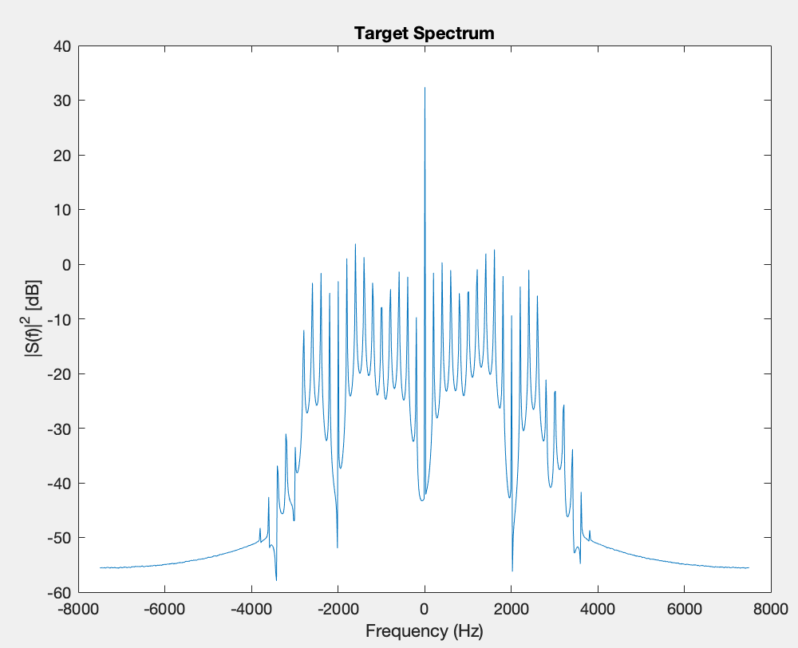
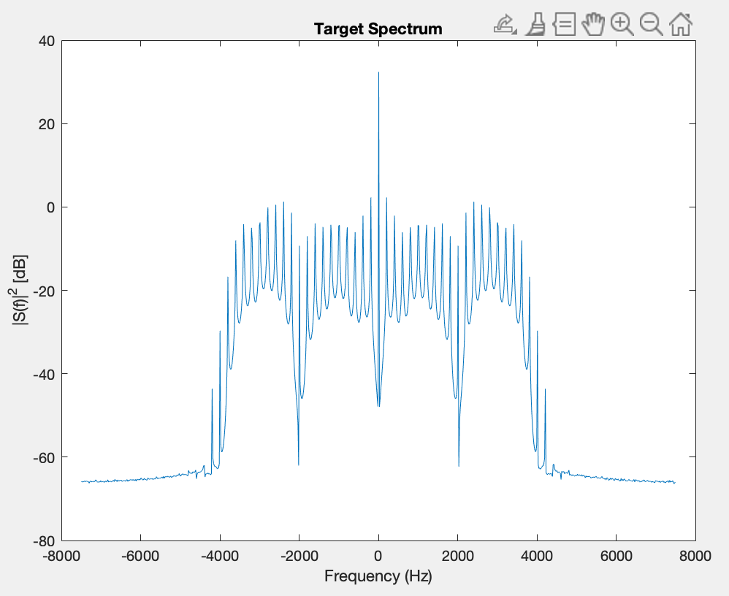

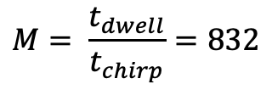


Phase contribution of rotors position
$$t_{chirp}=66.7 μs$$
$$M= \frac{t_{dwell}}{t_{chirp}}=832$$
$$t_{dwell}=55ms$$
$N=\frac{2Δt}{{ t}_{chirp}}$ = 30
Quadcopter spectrum
With phase contribution
Without phase contribution

Slide 9
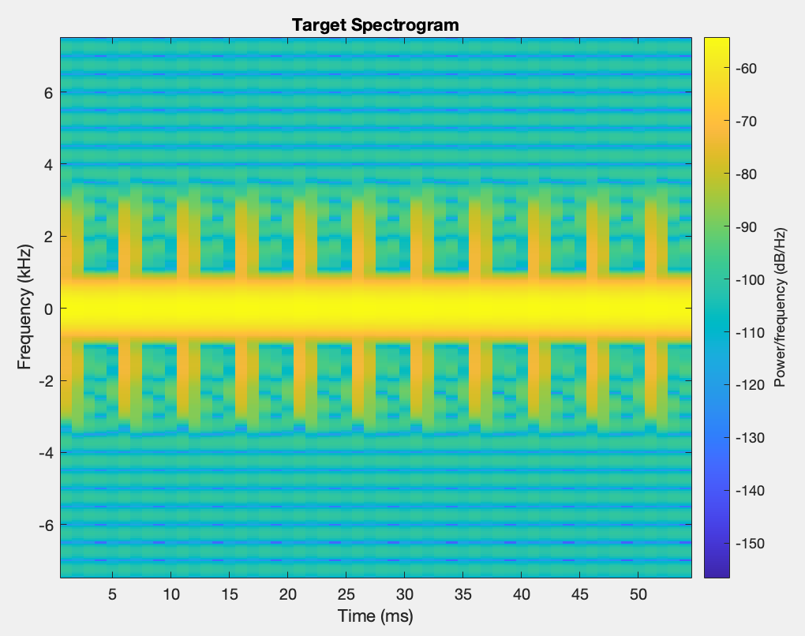
Phase contribution of rotors position
$$t_{chirp}=66.7 μs$$
$$M= \frac{t_{dwell}}{t_{chirp}}=832$$
$$t_{dwell}=55ms$$
$N=\frac{2Δt}{{ t}_{chirp}}$ = 30
Quadcopter spectrum
With phase contribution
Without phase contribution

Slide 10
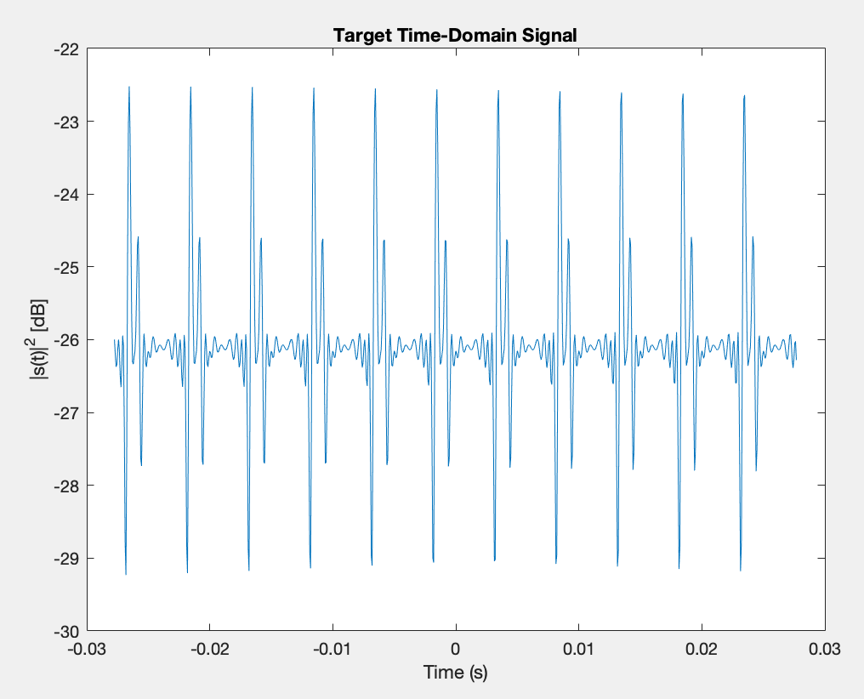
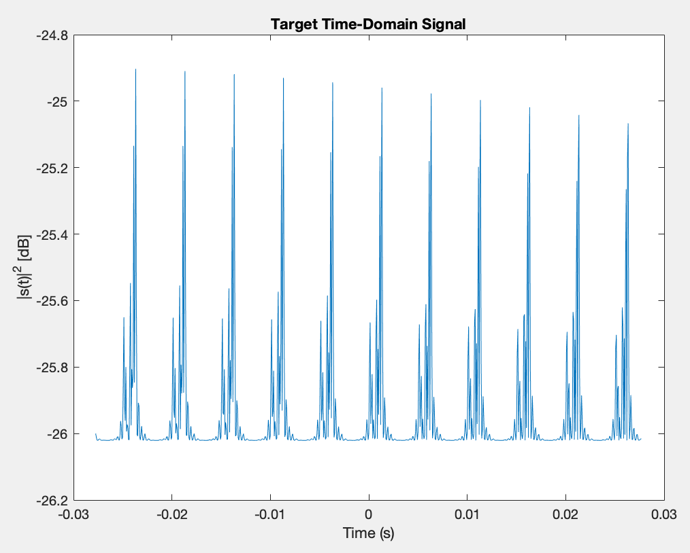
Phase contribution of rotors position
$$t_{chirp}=66.7 μs$$
$$M= \frac{t_{dwell}}{t_{chirp}}=832$$
$$t_{dwell}=55ms$$
$N=\frac{2Δt}{{ t}_{chirp}}$ = 30
Quadcopter spectrum
With phase contribution
Without phase contribution

